Slide 1
Introduction to OSPT & CIPURSE
Laurent Cremer
Executive Director
ElectroTrans 2018, Moscow
May 16th , 2018

Slide 2
OSPT Alliance in a Nutshell
Notes:
What is Cipurse & OSPT (2 minutes)
OSPT in a nutshell:
Who?
We are a not for profit organization created in 2011
We are run by The Articles of the Association which are published on our website
The General Meeting held every year is the top organ of management. All members are invited.
What?
OSPT drives the CIPURSE Specification for any kind of media (Paper Ticket, card, wearables and mobile) and beyond
Products need to be certified by a neutral 3rd party and are published on the website
Only members of the Association are entitled to use CIPURSE Trademark
Why?
Objective is to create a very large healthy market with non proprietary, interchangeable, inter-operable solutions for smart chip and HCE
How?
Developing new Specification through collaborative work from company members making sure the Specifications fit the market

Slide 3
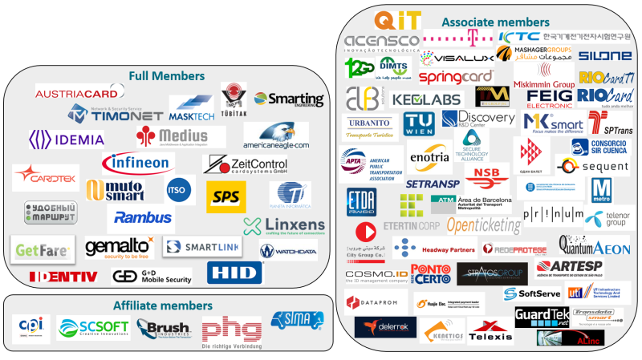
OSPT community: #90 members
Notes:
MORE ON “How does OSPT support the customers, designing in Cipurse (3 minutes)”, maybe in words during the speech.
WHAT ARE THE BENEFITS TO THESE PLAYERS?
How does OSPT support the customers, designing in Cipurse (3 minutes)
Why join our community?
Help shape and influence the role of the CIPURSE open standard
Network and collaborate with other individuals within your sector
Bridge with industry associations
Address the challenge of convergence between mobile and smart cards
Lead the governance of the standards specification (among participants, whether transport stakeholders, industry leaders or SMEs)
Product develop critical open specification components needed by the industry as necessary to facilitate the interoperability of the proposed standards as previously achieved for CIPURSETM
Refine the standards dissemination roadmap
Share the result of standards adoption with OSPT members (i.e. business intelligence)

Slide 4
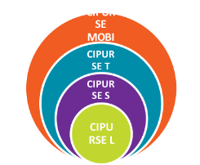
CIPURSE™ - The original objective (1)
CIPURSE V2 Model
Current Market Solution
CIPURSE profiles have a consistent design | Product levels have different memory structures
CIPURSE profiles are scalable | Solutions are NOT scalable
All specification levels use same memory structure/command set/algorithm/protocol | Different communication standards are used [e.g. ISO 14443-3 and ISO 14443-4]
CIPURSE guarantees coexistence of different ticket types in the same system | Security algorithms and command sets are different throughout the product levels
CIPURSE allows switching between ticket types and form factors | Can‘t use different products in the same transportation ecosystem without (expensive) software &/or hardware changes
Notes:
We have one specification and we define different profiles in a modern design where the functionality grows according to the requirements of your application.
You have a single use ticket or some account based system, use an L profile, you will get all the advantage of CIPURSE security in a very cost effective solution.
You want more functionality, with a real multi-application framework, then use a CIPURSE S or CIPURSE T profile.
Our strong point:
Unified design
Standard compliant
Multi Application from the start
And a Secure solution

Slide 5
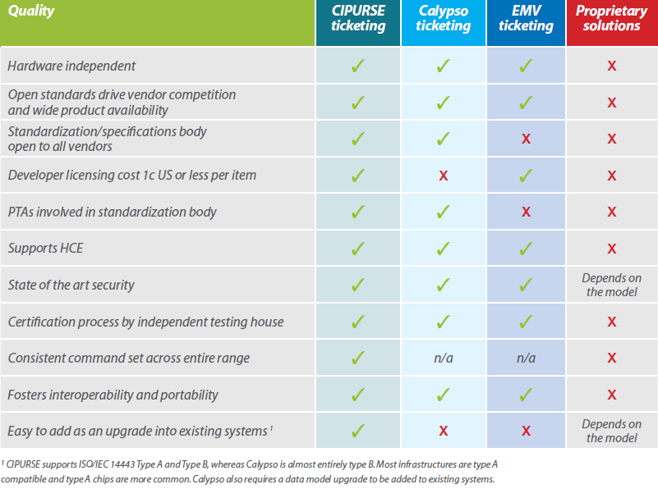
Comparasion CIPURSE vs. other platforms

Slide 6
OSPT Alliance – 2011/2018
21
90
members WW
19
Certified Products
1100
CIPURSE community
Distributed
SDK
112
+200
Notes:
News/Update of Cipurse standard's development (3-4 minutes)

Slide 7
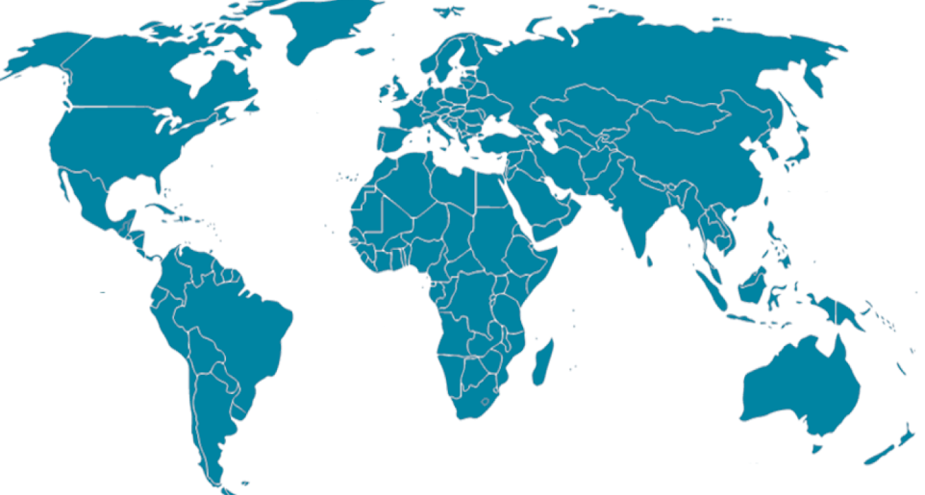
A perspective for CIPURSE in 2018: ”the most contagious strength is the example”
Projection 2020
11 projects
> 50% confidence launch
250M units
2017 projects
2018
Notes:
Existing milestones in 2017 with the Green flags: Barcelona/ATM in course of deployement by the end of 2018, Access Control in Germany, Event ticketing mobile application in 2016 in Hungary, Toll access project in the region of Sao Paulo, AFC Los Angeles Metropolitan Authority project including CIPURSE. An important project also in Russia whereas 14000 validators have been upgraded to read CIPURSE Cards in 3 regions of Russia federation.
The interesting thing is that at the end of 2017 and to be deployed in 2018, some very significant projects have come through:, basically in 2 verticals:
In transport with the introduction of CIPURSE cards into existing applications:
Mpeso System Integrator has been operating for 2 years the Public Transport of 600 buses in the capital of Nicaragua using Mifare+ cards. They have introduced CIPURSE cards and will use both from now on, introducing a very interesting competition use cases
The city of Cuenca , the 3rd one in Ecuador has shifted from Mifare Classic to CIPURSE with a 10 years old validator and system, without any stop in the service, just upgrading the System
The city of Curitiba in Brazil which is the 6th city in the country and has been for the last 20 years an early adopter of New Technologies in the Transport system and the 1st one to implement BRT solution WW
→these projects are very diversified in terms of technology providers as they have been realised by many different stakeholders from around the world: Korean and russian validators manufacturers, local PTOs & PTAs
→ there are hundred of cities using Mifare Classic in emerging countries , we understand the introduction of CIPURSE with a non proprietary and HW agnostic platform will be a game changer.
In the ID vertical with CIPURSE as the chosen platform for a country wide driving license project in Brazil: this is 66M driving license project for 1 single country, one application.
What is really important is that the CIPURSE spec has been chosen for good reasons:
Open Standard
Multi-Application
HW agnostic

Slide 8
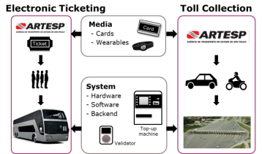
CIPURSE™ @ São Paulo Transport State Agency ARTESP
São Paulo
São Paulo Transport State Agency (ARTESP) is the responsible regulation authority for toll collection and Intercity Bus fare collection. ARTESP choose CIPURSE™ for the new automated systems to build on open standards.
Volume
> 100 million pieces per year
Scheme operator
ARTESP
System integrator
Quanta-IT
Card Supplier
Diverse
Infineon Products
CIPURSE™4move
CIPURSE™move
Milestone
Pilot in field is running
Notes:
ARTESP is the regulation authority in Sao Paulo State. It decided officially to go for open standards and CIPURSE™ for inter-city state busses and e-toll collection.
ARTESP is the regulation authority in Sao Paulo State with a population of 44 million people. It is the first big regulation authority in LATAM, which goes officially to open standards and CIPURSETM.

Slide 9
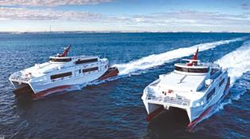
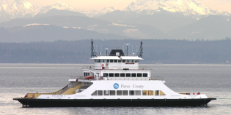
CIPURSE™ Washington Ferries
HMS Ferries
HMS Ferries launches a smart card system to further modernize the ticketing process based on the CIPURSE™ open security standard. This new account based ticketing solution enables a quicker boarding process and reduces cash handling.
Source: https://www.americaneagle.com/company/news/2016/08/31/americaneagle.com-revolutionized-ticketing-system
Volume
up to 100K pieces/year
Scheme operator
HMS Ferries Inc
System integrator
American Eagle
Infineon Products for tickets
CIPURSE™move
Milestone
in roll out

Slide 10
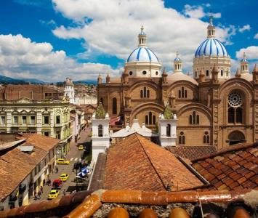
CIPURSE™ in Cuenca/ Equator
Cuenca
Volume
> 400K pieces per year
Scheme operator
Consorcio SIR Cuenca
System integrator
Planeta Informatica
Card Supplier
Logikard, Ecuador
Infineon Products
CIPURSE™4move (S Profile)
Milestone
Readers updated and migration to CIPURSE already started

Slide 11
Major deciders and projects in the USA
Los Angeles Country Metropolitan
Transportation Authority
Request for proposal for REP No. PS29117, TAP CARD Manufacturing and Fulfillment
Thursday, July 09, 2016
LA Metro and the TAP system use chip technology for its automated fare collection system. Chip shall be used in the form of smart cards, wristband or on mobile phone. As part of its efforts to ensure the greatest flexibility, costs and the demand for security LA Metro asks for CIPURSE™ Controller products.
Chair, Harold Brown, March, 13st 2016
Public Transport consortium (OSPT) provides the closest adherence to an “open” standard with its gremial in accordance with APTA’s definition of an open standard.
CIPURSE™ scheme was reviewed and determined closest to APTA’s definition of an open standard.
Notes:
CIPURSE has been also chosen by one of the most populated city in the US, integrated in the tender Specification of the Los Angeles Country Metropolitan Transport Authority

Slide 12
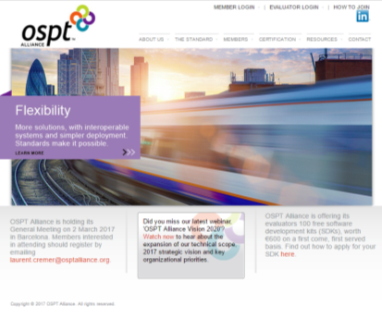
For more information
Thank You
To find out more about joining OSPT Alliance,
please email:
Laurent.cremer@osptalliance.org
Visit our website:
www.osptalliance.org
Join in the conversation on LinkedIn:
https://www.linkedin.com/grps/OSPT-Alliance-4392323/about

Slide 13
Agenda
OSPT: Who/What/Why/ How? → slides 3 to 6
CIPURSE origin → slides 7 to 10
Membership → slides 11 to 18
Specification & certification → slides 19 & 20
CIPURSE deployements → slides 21 to 32

Slide 14
CIPURSE OPEN STANDARD: Get all Value-chain players around the table
MORE ON “How does OSPT support the customers, designing in Cipurse (3 minutes)”, maybe in words during the speech.
WHAT ARE THE BENEFITS TO THESE PLAYERS?
WE SKIP THE 7.
Service Providers
Govt agencies
Standard Body
Transit agencies
Consultants
Industry:
Chip
Card
HW
SW Developer
System Integrator
Notes:
How does OSPT support the customers, designing in Cipurse (3 minutes)
Looking at the members, you can follow the path followed by the Alliance along its 7 years of existence.
The members of OSPT Alliance covers the whole Value Chain.
It started with a card spec 5 years ago, and its corresponding certification program, then a SAM spec has been published, and we have showed in the last years how much our members are looking at the HCE opportunity through a WP, then a POC, and now we are on the verge to produce the HCE specs. In // we will also produce a reader spec and the Alliance is actively looking on how to elaborate further.
It is important to notify here that this is not an OSPT decision, it is simply the request from the members to elaborate further. So to make things VERY clear this Alliance cannot be quoted as owned by a single, or by few

Slide 15
The key pillars of OSPT Alliance
Specifications
Certification
Members
Resources

Slide 16
CIPURSETM Mobile based on CIPURSE™ V2 R2 Specification
Notes:
Designed for multi-application support
CIPURSE, access, couponing, loyalty, payment and others on secure elements
Single, consistent set of specifications for all the security, personalization, administration and lifecycle management functions needed to create a broad range of interoperable applications

Slide 17
The Proprietary Top-down approach VS CIPURSE Bottom-up approach
Existing ticketing systems are top down
CIPURSE
Based on user requirements
They are supplier dictated
They lack of flexibility
Future ticketing systems are bottom up
Notes:
The aim of this slide is to demonstrate OSPT Alliance’s ‘bottom up’ approach to ticketing solutions.
The bottom-up approach used by OSPT Alliance is flexible, forward thinking and focussed around user requirements, rather than proprietary systems which are dictated by the existing solutions that service providers hold, offering little flexibility.

Slide 18
CIPURSE™ - The original objective (2)
→ Bridge solution providers diversity with user flexibility
Notes:
Mass transit ridership is experiencing record growth due to urbanisation and other factors.
Transit agencies globally are straining to meet this demand and are seeking upgrades and replacements for their ageing fare collection systems.
The transit industry is undergoing a technology sea change as older coin, token and flash pass-based systems evolve to accept payments from mobile phones as well as the latest generation of contactless cards.
Yet, transit agencies are under unprecedented pressure to reduce the cost of operations without reducing services.
Unlike any time in the past, agencies are recognising the need for and the benefits of standards.
Using open standards would:
Reduce costs of implementation and operations and avoid the financial, contractual and technical barriers associated with non-standard, proprietary products
Ensure interoperability with other transit fare systems and different media within the same region and ensure that consumables are available from a variety of vendors that offer interoperable products to ensure continuous supply and competitive pricing
Create an easy migration path to mobile ticketing
Provide advanced security to prevent fraud, avoid public embarrassment and minimize legal liability

Slide 19
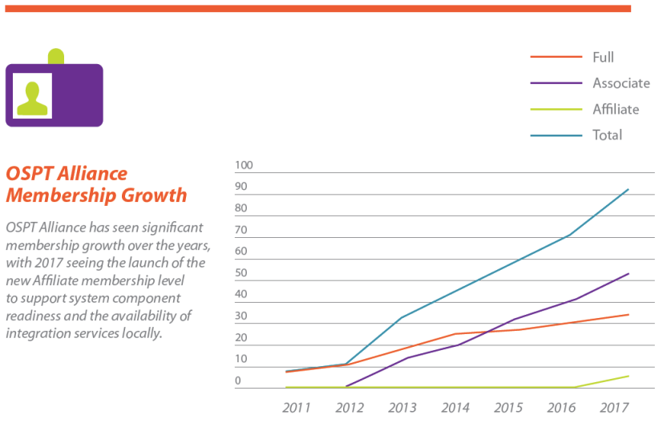
Momentum accelerating

Slide 20
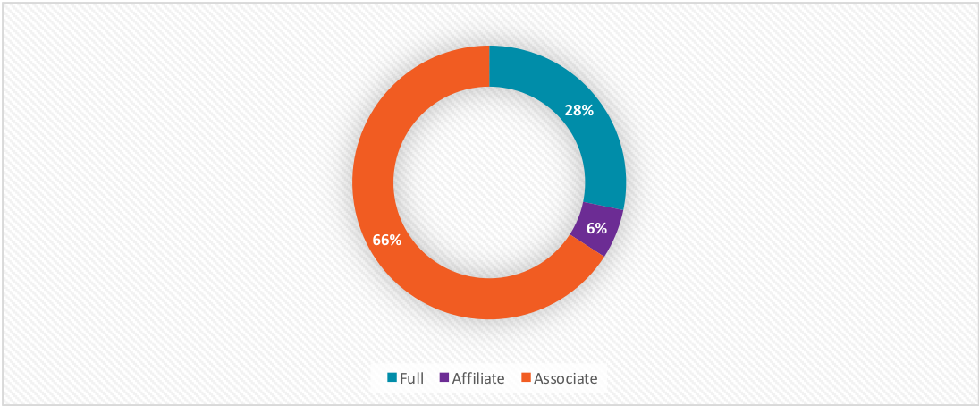
OSPT: members per membership category
Category | Benefits | Rights
Full Member | - CIPURSE implementation - Ability to submit products for certification - Elaboration of Specifications - CIPURSE Trademark license - Participation to WGs - Voting right at the General Assembly | Ability to certifiy CIPURSE products: - 19 products certified - 7 vendors - 3 chip suppliers
Affiliate Member | - CIPURSE implementation at the transmitting level - Participation to the System Integration WG - Participation to the GM (no voting right) | - Ability to certify readers (whenever Specification is published)
Associate Member | - Participation to some WGs (by invitation) - Participation to the GM (no voting right) | NA
Notes:
Associate members:
capacity to influence the market evolution through Specification

Slide 21
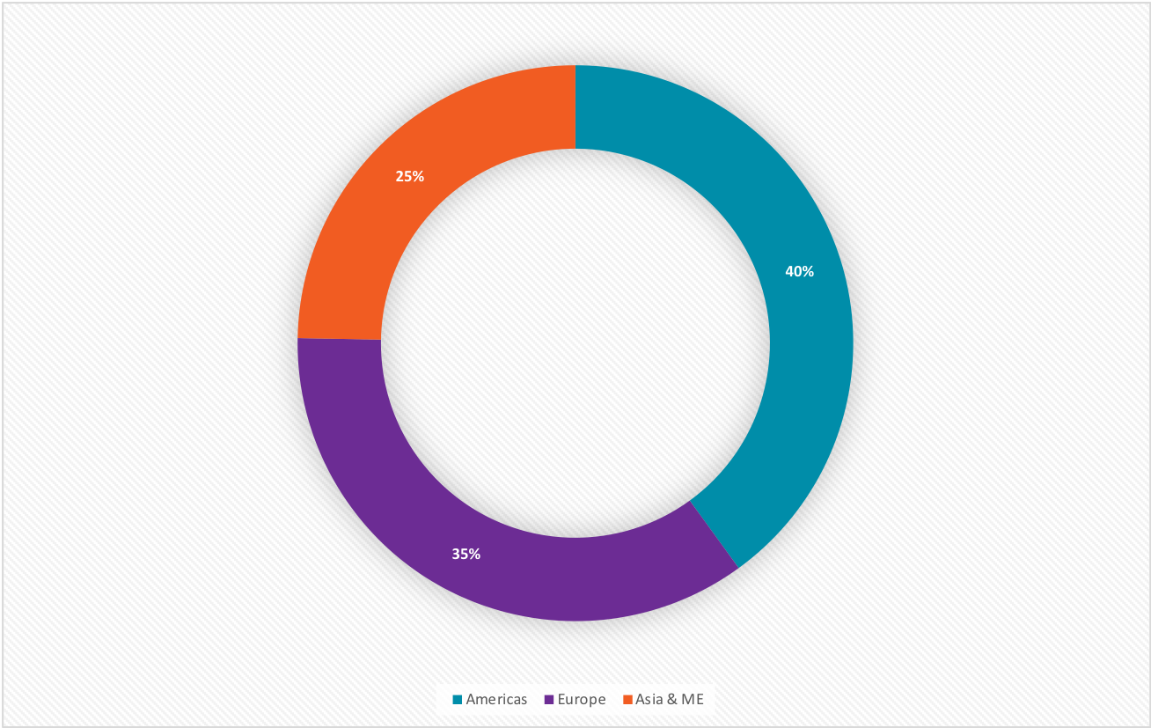
OSPT: Members per region
Notes:
Boa reparticao entre as 3 regioes
Still Americas region is leading with 35 members

Slide 22
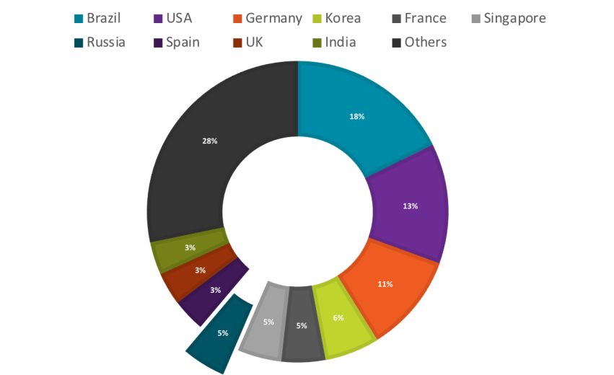
OSPT: Members per country

Slide 23
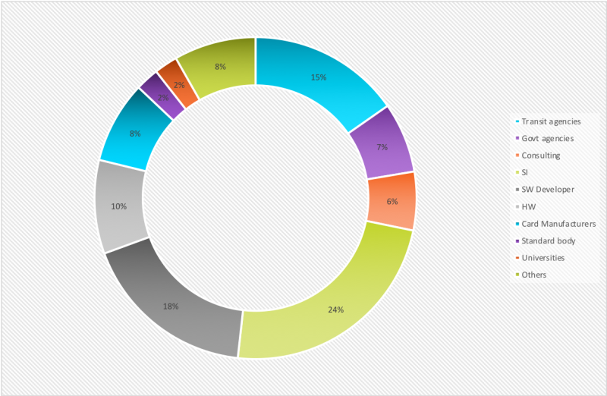
OSPT: Members per positionning on the Value Chain
Notes:
Os membros OSPT cubrem a maior parte da Cadeia de Valor
Mas especificamente, sao 6 categorias mas importantes:
As agencias de transito (15%) e de governo (22%) que sao as empresas que especificam os produtos que vao usar: podemos ver que as agencias percebem muito bem o interes de um estandar aberto
Os integradores de sistemas (24%) e os desenvolvedores de SW (18%) que integrao o estandar CIPURSE para propor a solucao aos seus clientes. E importante notar que tem muitos integradores de sistemas desses que estao presente no Brasil
Os desenvolvedores de produtos : leitores com 18% e cartoes com 10%

Slide 24
CIPURSE enables mobility services

Slide 25
CIPURSE certified Products
7 companies
19 products
3 chip providers
# 30 products by end 2018

Slide 26
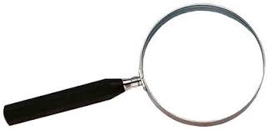
The tornado effect
Notes:
So OSPT is like an iceberg: the visible part is a very small portion of the total and we expect to get massive new projects in 2018-2019.
The reason for this is that we are all convinced that “the most contagious strength is the exemple”
Let’s see now how CIPURSE can respond to Smart City uses cases

Slide 27
CIPURSE Specifications: The outcome of the Value Chain players
HCE: WP & POC
Certification
Cards & SAM
Reader & APIs
2018- 2019
2011- 2013
2014
2016- 2018
Notes:
Evolution of the specifications along the timeline: SIs, SW developers and Solution providers are bringing in their expertise to the original Card Specifications to develop further the « Open Standard » paradygm shift.

Slide 28
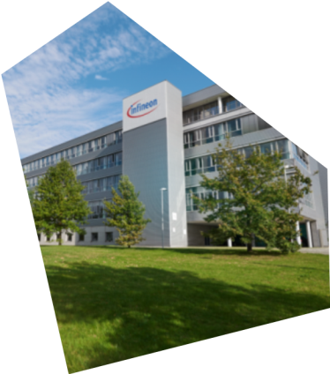
Success stories– CIPURSE™
Access Control airports/Korea
Mobile Event Ticketing/
Hungria
AFC/ Barcelona region
Russia
Access control Austria/Alemania
São Paulo/ Brasil
Tiketing HMS Ferries/USA
Notes:
Today CIPURSE is used for many applications. In Germany, many company identity cards are based on CIPURSE, in Hungary the German Telekom used CIPURSE as secure data container for event tickets. In Brazil CIPURSE used when paying taxi fares, and in Medellin passengers can pay with a CIPURSE-based ticket both their taxi as also drive bus. And in Barcelona is the whole transport infrastructure of the region around Barcelona - including tolls on city highways - modernized with a CIPURSE-based solution.

Slide 29
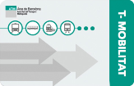
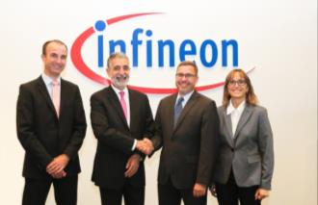
CIPURSE™ @ ATM Barcelona
ATM Barcelona
The new "T-Mobilitat" electronic fare collection system will improve the urban mobility in Barcelona and Catalunya. Soon all passengers can travel with an all-in-one card the public transport in Barcelona, can rent a bike or even pay his etoll. Infineon supplies the security chips for the "T-Mobilitat" infrastructure – for both the chip-based tickets, that work contactless, as well as validators based on the advanced security standard CIPURSE™.
Volume
100 million ​contactless tickets per year
2 million smart cards per year
Scheme operator
ATM Bercelona
System integrator
Indra
Card Supplier
Diverse
Infineon Products for tickets
CIPURSE™Security Controller
CIPURSE™move
Infineon Products for infrastructure
SLE 97
Milestone
Infineon products are qualified
Notes:
Barcelona is upgrading their old Automatic Fare Collection system via a complete urban mobility concept for the whole Catalunya area based on CIPURSE. The new "T-Mobilidad" card can be used to travel bus and metro, but also to rent bikes or pay e-toll.
Barcelona is the first Light house project in Europe for Smart Urban Mobility based on CIPURSE

Slide 30
Brasil Driving License project
To be launched in january 2019
66M country-wide

Slide 31
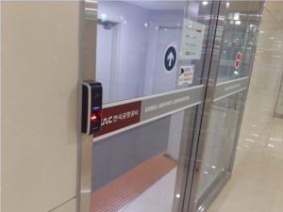
CIPURSE™ as Employee badges for Korea Airports
Korea Airports
To strengthen airport access control systems for its personnel, Korea Airports Corporation has been implementing a new solution based on the CIPURSE™ security standard for its employee badges.
Volume
50K cards issued
Scheme operator
Korea Airport Corporation
System integrator
Guardtech
Card Supplier
PureSmart
Infineon Products
CIPURSE™Security Controller for badges
CIPURSE SAM for the door reader
Milestone
Fully implemented and running at 3 Korean Airports

Slide 32
CIPURSE™ as payment & access control
Brazil
Using a contactless CIPURSE™ card and a mobile app, ZigPay offers end customers a new user experience at bars and events allowing convenient payment and access control
Volume
500kpcs / yr
Scheme operator
ZigPay
System integrator
ZigPay
Card Supplier
Evolution, Valid
Infineon Products
CIPURSE™ move for PVC cards, paper tickets and bracelets
Milestone
Fully implemented and working in Sao Paulo and Bahia states

Slide 33
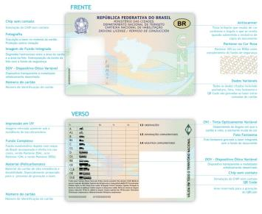
CIPURSE™ Brasilian Driving license
DENATRAN
The Brazilian Driver´s License was announced to be made as Policarbonate card with a CIPURSE chip. The document presently issued in paper presents a major change and it is based on a pure NFC interface to facilitate inspection and control
Volume
66M cards
Scheme operator
DENATRAN
System integrator
SERPRO
Card Supplier
Several
Infineon Products
CIPURSE™Security Controller for ID
CIPURSE SAM card issuance
Milestone
Scheduled to be compulsory Jan/2019

